Slide 1
Design Patterns in C# The 23 Gang Of Four Patterns
David Sackstein,
John Bryce Training

Slide 2
What are Design Patterns?
Design Patterns harness object orientation to promote reusability, extensibility and ease of maintenance.
“Design patterns are recurring solutions to design problems you see over and over.” (The Smalltalk Companion, James W. Cooper)

Slide 3
What are Design Patterns (cont)
Most patterns and design principles address issues of change in software.
Most patterns allow some part of a system to vary independently of other parts.
Patterns provide a shared language among developers.
Patterns don’t give you code, they give you experience.

Slide 4
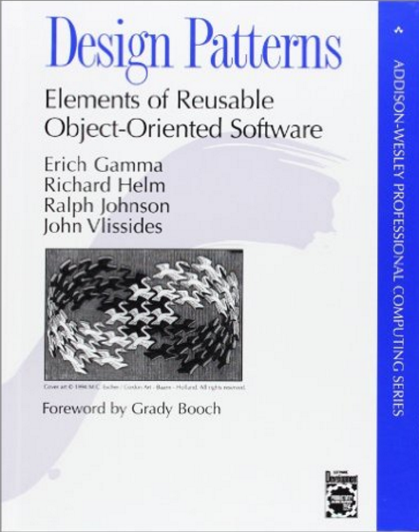
The GOF Patterns
The 23 Gang of Four (GoF) patterns are generally considered the foundation for all other patterns.

Slide 5
The 23 Gang Of Four Patterns
What are Design Patterns?
Creational Patterns
Structural Patterns
Behavioral Patterns
Summary

Slide 6
Creational Patterns
Factory Method
Prototype
Abstract Factory
Builder
Singleton

Slide 7
Structural Patterns
Façade
Adapter
Proxy
Bridge
Decorator
Composite
Flyweight

Slide 8
Behavioral Patterns
Observer
Template Method
State
Strategy
Command
Iterator
Visitor

Slide 9
Behavioral Patterns (cont)
Chain of Responsibility
Mediator
Memento
Interpreter

Slide 10
Creational: Factory Method (1/5)
Define an interface for creating an object, but let subclasses decide which class to instantiate. Factory Method lets a class defer instantiation to subclasses.
Notes:
All factory patterns promote loose coupling between clients and concrete implementations.
Defines an interface for creating an object but lets subclasses decide which to create.
Factory relies on inheritance.
Abstract Factory relies on object composition.
The intent of Factory is to defer instantiation to subclasses. The intent of Abstract Factory is to create families of related objects.

Slide 11
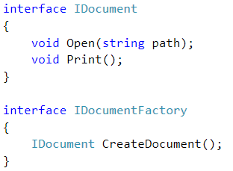
Example: Interfaces

Slide 12
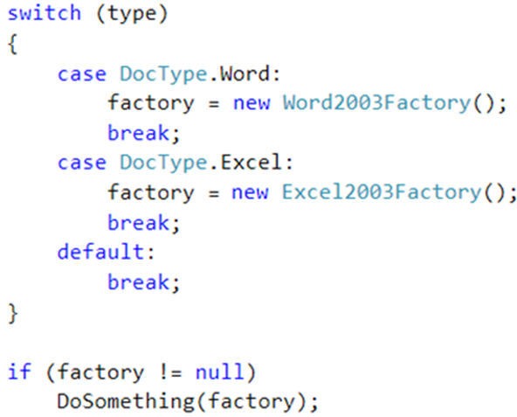
Example: Create Factory

Slide 13
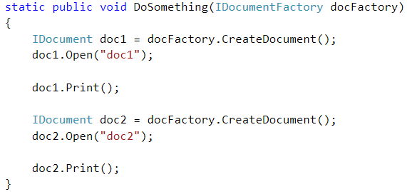
Example: Use Factory

Slide 14
Creational: Prototype (2/5)
Specify the kind of objects to create using a prototypical instance, and create new objects by copying this prototype

Slide 15
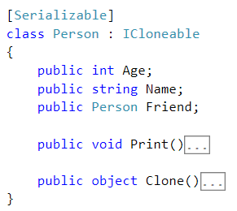
Example: ICloneable

Slide 16
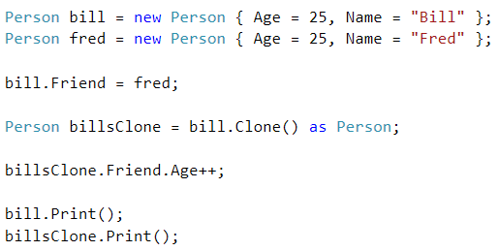
Example: How old is Fred?

Slide 17
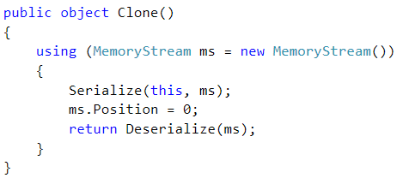
Example: Implementing ICloneable

Slide 18
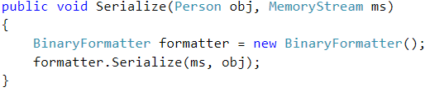
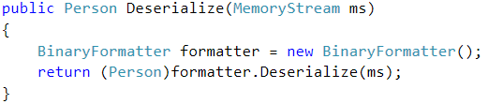
Example: Implementing ICloneable

Slide 19
Creational: Abstract Factory (3/5)
Provide an interface for creating families of related or dependent objects without specifying their concrete classes

Slide 20

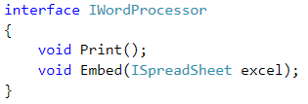
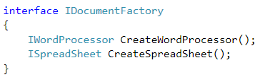
Example: Interfaces

Slide 21
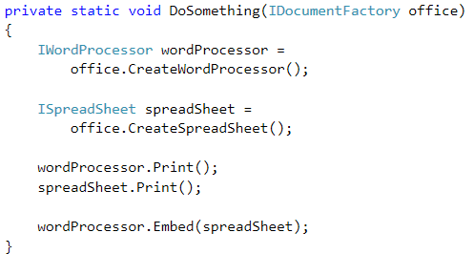
Example: Use Factory

Slide 22
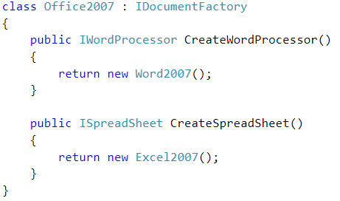
Example: Implementation (1)

Slide 23
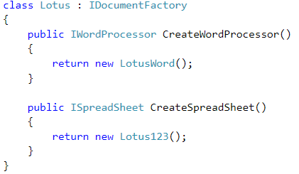
Example: Implementation (2)

Slide 24
Creational: Builder (4/5)
Separate the construction of a complex object from its representation so that the same construction process can create different representations.

Slide 25
Creational: Singleton (5/5)
Ensure a class has only one instance and provide a global point of access to it.
Notes:
Ensures you have at most one instance of a class and provides a global access point to it.
Double checked locking can be used to improve performance.

Slide 26
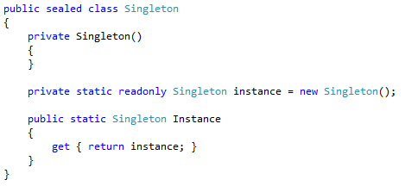
Example: Singleton

Slide 27
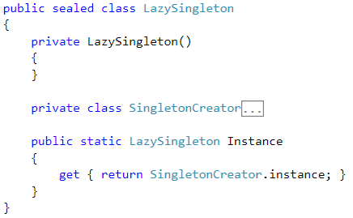
Example: Lazy Singleton (1)

Slide 28
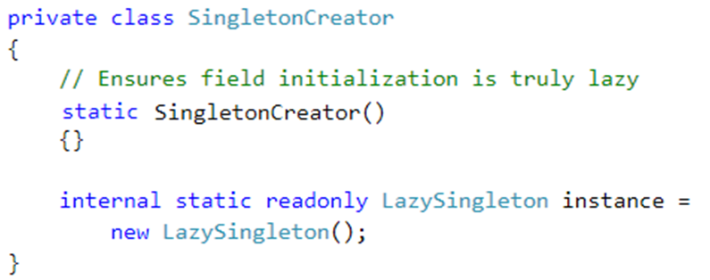
Example: Lazy Singleton (2)

Slide 29
Structural: Façade (1/7)
Provide a unified interface to a set of interfaces in a subsystem. Façade defines a higher-level interface that makes the subsystem easier to use.

Slide 30
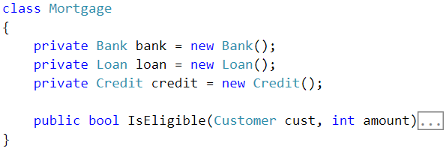
Example

Slide 31
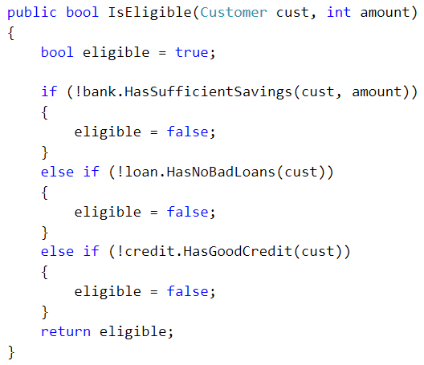
Example: Implementation

Slide 32
Structural: Adapter (2/7)
Convert the interface of a class into another interface clients expect. Adapter lets classes work together that couldn't otherwise because of incompatible interfaces.

Slide 33
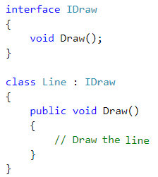
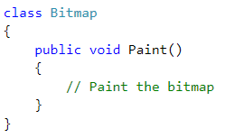
Example: Compatible?

Slide 34
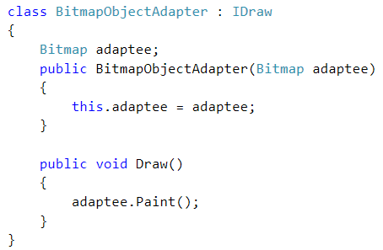
Example: Implement Adapter

Slide 35
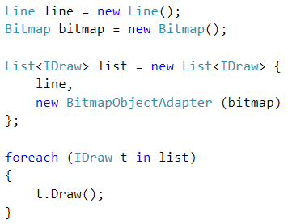
Example: Usage

Slide 36
Structural: Proxy (3/7)
Provide a surrogate or placeholder for another object to control access to it.

Slide 37
Structural: Bridge (4/7)
Decouple an abstraction from its implementation so that the two can vary independently.

Slide 38
Structural: Decorator (5/7)
Attach additional responsibilities to an object dynamically. Decorators provide a flexible alternative to subclassing for extending functionality.
Notes:
Decorator provides a an alternative to subclassing.
Inheritance is one way of extension, but not necessarily the best.
Composition and delegation offer run-time extension.
Our designs should allow behavior to be extended without requiring change.
Decorator classes mirror the type of the components they decorate.
You can wrap a component with any number of decorators.
Decorators can result in many small objects in our design, and overuse can be complex.

Slide 39

Example: Abstract Component

Slide 40
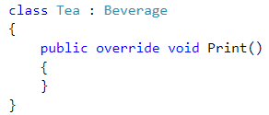
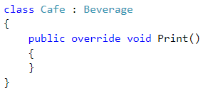
Example: Concrete Components

Slide 41
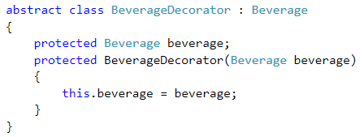
Example: Decorator

Slide 42
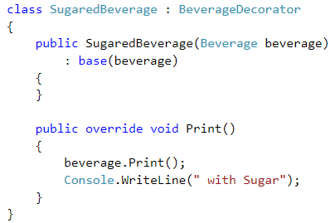
Example: Concrete Decorator (1)

Slide 43
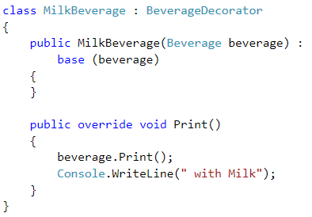
Example: Concrete Decorator (2)

Slide 44
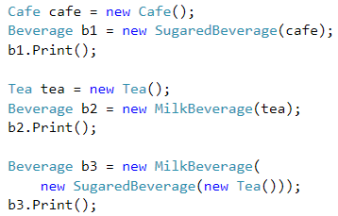
Example: Usage

Slide 45
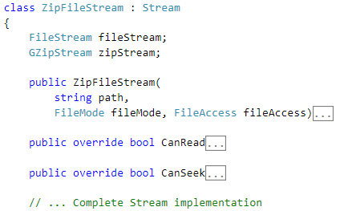
Another Example (partial)

Slide 46
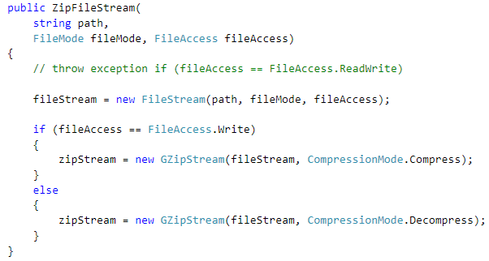
Another Example (partial)

Slide 47
Structural: Composite (6/7)
Compose objects into tree structures to represent part-whole hierarchies. Composite lets clients treat individual objects and compositions of objects uniformly.

Slide 48
Structural: Flyweight (7/7)
Use sharing to support large numbers of fine-grained objects efficiently.

Slide 49
Behavioral: Observer (1/11)
Define a one-to-many dependency between objects so that when one object changes state, all its dependents are notified and updated automatically.
Notes:
Defines a one to many relationship between objects
Subjects update Observers using a common interface.
Observers are loosely coupled in that the Subject knows nothing about them.
You can push or pull date from the Subject.
Don’t rely on particular order of notification.

Slide 50
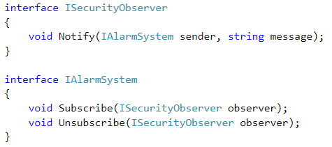
Example: Interfaces

Slide 51
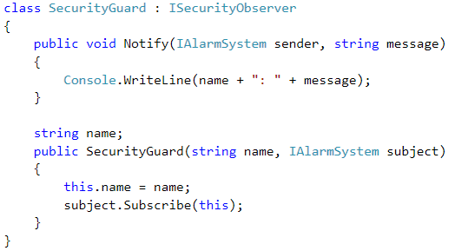
Example: Implementation (1)

Slide 52
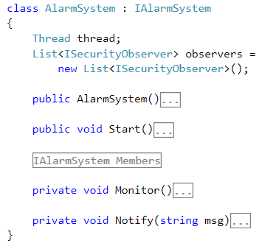
Example: Implementation (2)

Slide 53
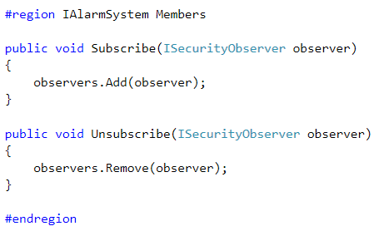
Example: Implementation (3)

Slide 54
Behavioral: Template Method (2/11)
Define the skeleton of an algorithm in an operation, deferring some steps to subclasses. Template Method lets subclasses redefine certain steps of an algorithm without changing the algorithm's structure

Slide 55
Behavioral: State (3/11)
Allow an object to alter its behavior when its internal state changes. The object will appear to change its class.

Slide 56
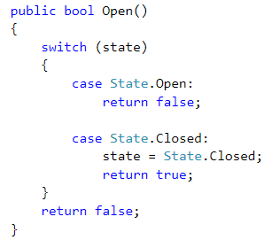
Example: Before (1)

Slide 57
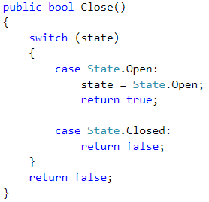
Example: Before (2)

Slide 58
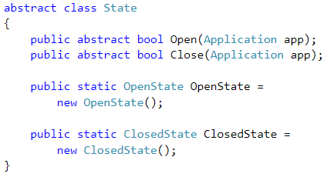
Example: After (Abstract State)

Slide 59
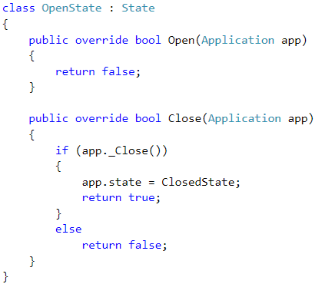
Example: After (Concrete States)

Slide 60
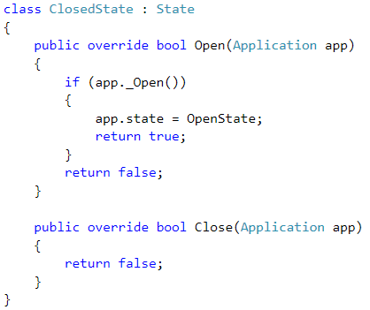
Example: After (Concrete States)

Slide 61
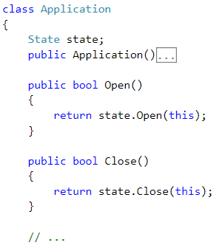
Example: After (Application Class)

Slide 62
Behavioral: Strategy (4/11)
Define a family of algorithms, encapsulate each one, and make them interchangeable.
Strategy lets the algorithm vary independently from clients that use it.

Slide 63
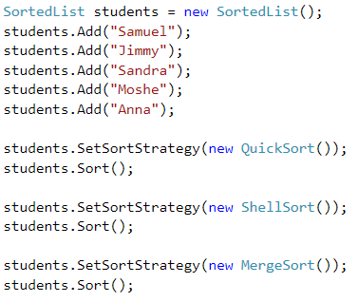
Example: Typical Use

Slide 64
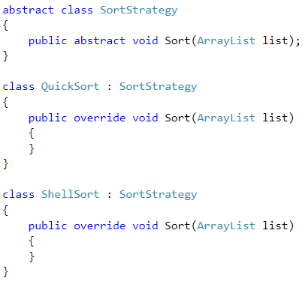
Example: Strategies

Slide 65
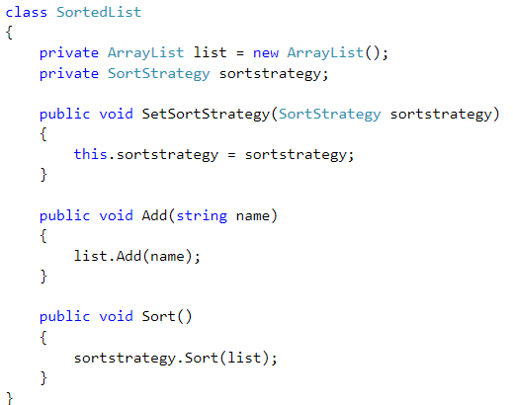
Example: Using the strategy

Slide 66
Behavioral: Command (5/11)
Encapsulate a request as an object, thereby letting you parameterize clients with different requests, queue or log requests, and support undoable operations.
Notes:
Encapsulates commands as objects allowing you parameterize other objects with different requests, queue or log requests, and support undoable operations.
Decouples an object requesting the operation and the receiver that knows how to perform it.
Command can support macros, undo, logging etc.

Slide 67
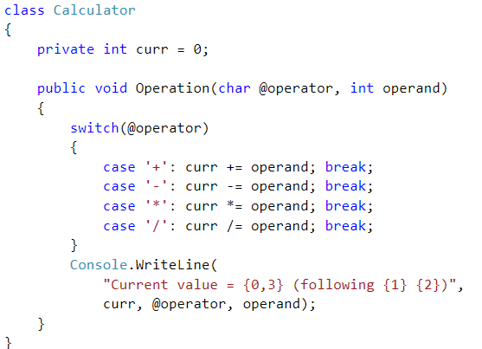
Example: Receiver

Slide 68
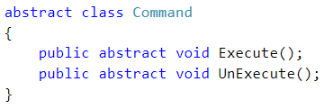
Example: Command

Slide 69
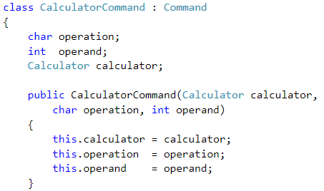
Example: Concrete Command (1)

Slide 70
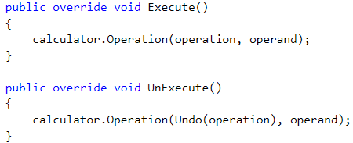
Example: Concrete Command (2)

Slide 71
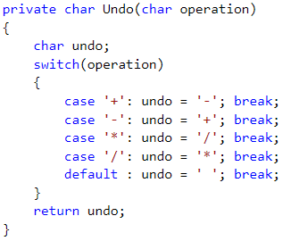
Example: Concrete Command (3)

Slide 72
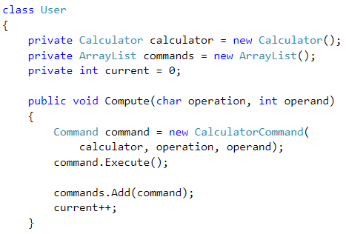
Example: User (1)

Slide 73

Example: User (2)

Slide 74

Example: User (3)

Slide 75
Behavioral: Iterator (6/11)
Provide a way to access the elements of an aggregate object sequentially without exposing its underlying representation

Slide 76

Example: IEnumerable

Slide 77

Example: IEnumerator (1)

Slide 78

Example: IEnumerator (2)

Slide 79

Example: Usage

Slide 80
Behavioral: Visitor (7/11)
Represent an operation to be performed on the elements of an object structure. Visitor lets you define a new operation without changing the classes of the elements on which it operates.

Slide 81
Double Dispatch Idiom
The problem:
We have a graphics editor that can display shapes
We need to be able to know if two shapes intersect one another
The calculation depends on the types of both objects.
How can we know if two polymorphic shapes intersect when we only have access to the base class?

Slide 82
Double Dispatch Idiom (cont)
Why is this a problem?
The left hand side is resolved dynamically through virtual a table
The right hand side (parameter) is resolved by the type of the reference.
Solution
Delegate through the virtual table of the right hand side (parameter)

Slide 83

Example

Slide 84

Example: What should be printed?

Slide 85

Example: Implementation (1)

Slide 86

Example: Implementation (2)

Slide 87
Behavioral: Chain of Resp. (8/11)
Avoid coupling the sender of a request to its receiver by giving more than one object a chance to handle the request. Chain the receiving objects and pass the request along the chain until an object handles it.

Slide 88
Behavioral: Mediator (9/11)
Define an object that encapsulates how a set of objects interact. Mediator promotes loose coupling by keeping objects from referring to each other explicitly, and it lets you vary their interaction independently.

Slide 89
Structural: Memento (10/11)
Without violating encapsulation, capture and externalize an object's internal state so that the object can be restored to this state later..

Slide 90
Behavioral: Interpreter (11/11)
Given a language, define a representation for its grammar along with an interpreter that uses the representation to interpret sentences in the language.

Slide 91
Patterns Summary

Slide 92
Five Creational Patterns
Creates an instance of several derived classes | Factory Method
A fully initialized instance to be copied or cloned | Prototype
Creates an instance of several families of classes | Abstract Factory
Separates object construction from its representation | Builder
A class of which only a single instance can exist | Singleton

Slide 93
Seven Structural Patterns
A single class that represents an entire subsystem | Façade
Match interfaces of different classes | Adapter
An object representing another object | Proxy
Separates an object’s interface from its implementation | Bridge
Add responsibilities to objects dynamically | Decorator
A tree structure of simple and composite objects | Composite
A fine-grained instance used for efficient sharing | Flyweight

Slide 94
Eleven Behavioral Patterns
A way of notifying change to a number of classes | Observer
Defer the exact steps of an algorithm to a subclass | Template Method
Alter an object's behavior when its state changes | State
Encapsulates an algorithm inside a class | Strategy
Encapsulate a command request as an object | Command
Sequentially access the elements of a collection | Iterator

Slide 95
Behavioral Patterns (cont)
Defines a new operation to a class without change | Visitor
A way of passing a request between a chain of objects | Chain of Responsibility
Defines simplified communication between classes | Mediator
Capture and restore an object's internal state | Memento
A way to include language elements in a program | Interpreter

Slide 96
Questions?

